Slide 1

Group Project
METC-111
12/11/2018
By: James Zartman, Jonas Smith, Elijah Hon

Slide 2
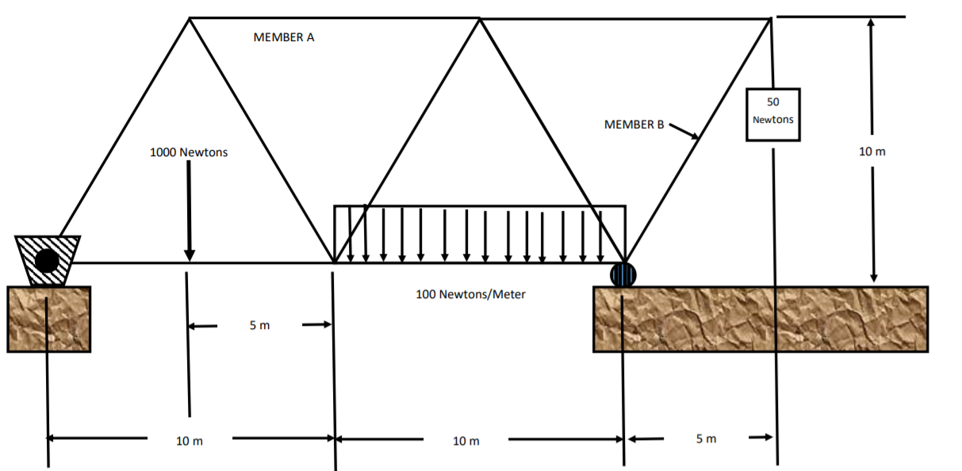
SCopE
This is a drawing of one side of a bridge that spans a small river. It will carry people and small vehicles to a wildlife exhibit.

Slide 3
Problem
The team was asked to calculate the load in member A and B (as shown in picture) as well as determine if the member is in tension or compression for the following circumstances:
  With the 50 newton sign alone
  Adding the 1000 newton load
  Adding the distributed load

Slide 4
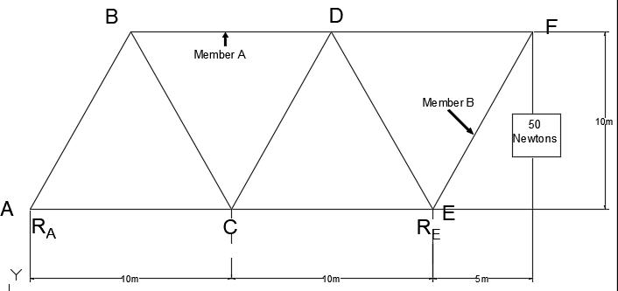
Calculations 50 NEWTON SIGN ALONE
Draw a Free body diagram.
Calculate the reactions at point E by using moments about point A
Then sum the forces in the “Y” direction to solve for the reaction force at point A
∑M_{A}= 0 =-(50)(25) + (R_{E})(20)
R_{E}= 1250-20
R_{E} = 62.5N
∑F_{Y} =0= -50+62.5-R_{A}
  R_{A}= 62.5-50
  R_{A}= 12.5N

Slide 5
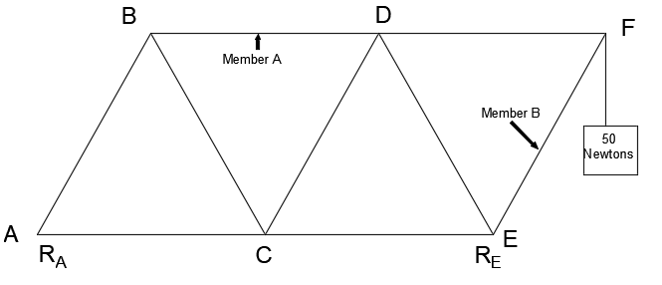

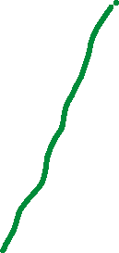
Calculations 50 NEWTON SIGN ALONE
Next we need to solve for the forces of each member. To do this we have to use the method of sections to solve for the members.
The picture to the right shows where we drew our lines to evaluate the sections dictated by the green lines.

Slide 6
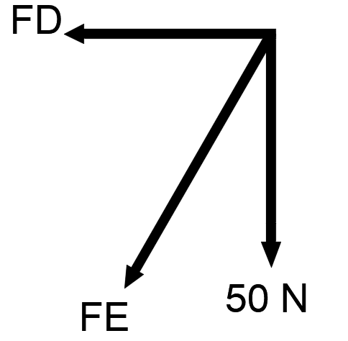
Calculations 50 NEWTON SIGN ALONE
Draw a free body diagram of the section we are solving for
We can use the sum of the forces in the y-direction to solve for member B.
∑FY=0=50N + FE(cos(30))
  FE=-50/(cos(30))
  FE= -58N
Since the answer is negative it means that our assumption of tension was incorrect and the member is actually in compression.
So FE= 58N (C)
This is the answer for member B in all 3 scenarios due to FD and FE being zero force members. So we will not solve for Member B anymore.
FREE BODY DIAGRAM

Slide 7
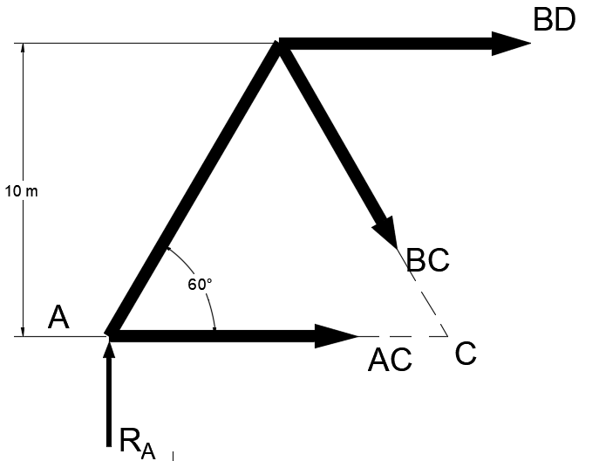
Calculations 50 NEWTON SIGN ALONE
Calculating the force in Member A
Draw a free body diagram of section
Take moments about point C.
∑M_{C}=0= -(BD)(10)+(12.5N)(10)
BD= 12.5 (T)

Slide 8
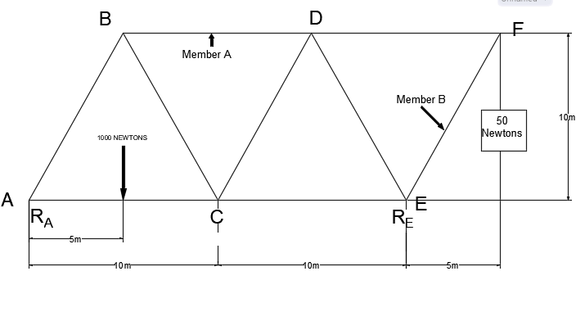
Calculations for 50 newton sign and 1000N
Draw a Free body diagram.
Calculate the reactions at point E by using moments about point A
Then sum the forces in the “Y” direction to solve for the reaction force at point A
∑M_{A}=0= -(50N)(25)-(1000N)(5)+(R_{E})(20)
R_{E}= 6250/20
R_{E}= 312.5N
∑F_{Y}=0= -50+312.5N-1000N+R_{A}
  R_{A}= 737.5N

Slide 9
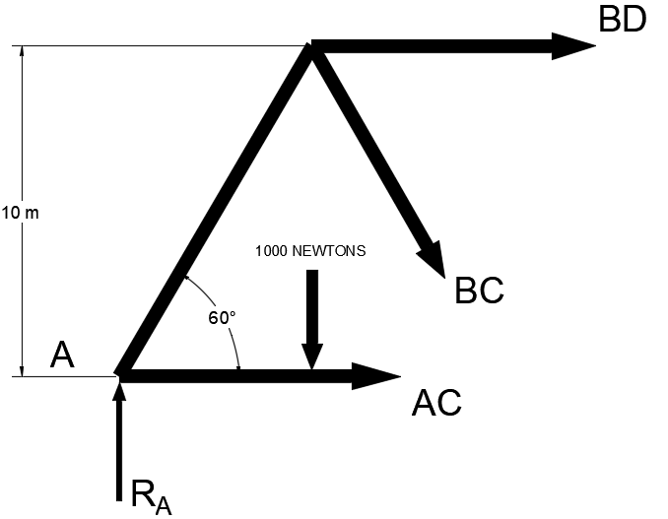
Calculations 50 NEWTON SIGN and 1000N
Calculating the force in Member A
∑MC=0= (1000)(5)- (737.5)(10)-BA(10)
5000-7375=10(BD)
-2375/10= BD
BD= -237.5
BD= 237.5 (C)

Slide 10
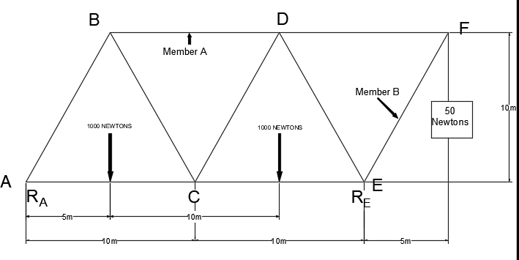
Calculations for 50 newton sign and 1000N
Draw a Free body diagram.
Calculate the reactions at point E by using moments about point A
Then sum the forces in the “Y” direction to solve for the reaction force at point A
∑M_{A}=0= -(50N)(25)-(1000N)(5)-(1000N)(15)+(R_{E})(20)
R_{E}= 21250/20
R_{E}= 1062.5N
∑F_{Y}=0= -50+1062.5N-1000N-1000N+R_{A}
  R_{A}= 987.5N

Slide 11
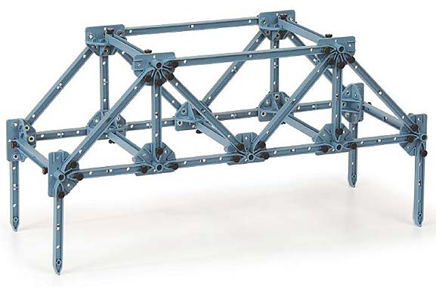
Build a Model to represent our bride
WE unfortunately didn’t take a picture of our one side of the bridge but here is a sample of the equipment we worked with.
Photo credit: https://www.pasco.com/prodCatalog/ME/ME-6990_truss-set/index.cfm

Slide 12
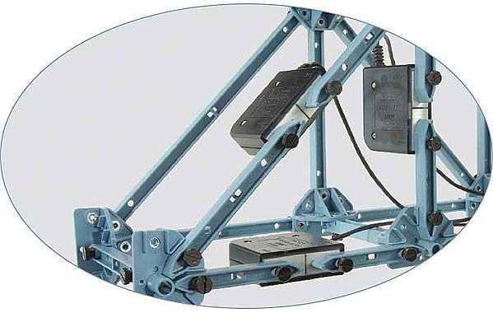
Install load cells an apply loading to verify calculations.
We also didn’t get the opportunity to perform load through the program.
This is a representation of the load cells that we would have used.
Photo credit: https://www.pasco.com/prodCatalog/ME/ME-6990_truss-set/index.cfm

Slide 13
Findings
The more loading that we added the higher the reaction forced needed to be to prevent the structure from spinning.
The more load added also increased the forces seen by member A
Member B forces stayed the same because it was apart of a zero force member
The closer the load was to the moment the higher the reaction force needed to be

